Slide 1




Neuromorphic Control of Embodied Central pattern generators
A Bio-Inspired Approach to Motion
By Christian Fernandez Lorden
Presentation for the Major project in electrical engineering

Slide 2
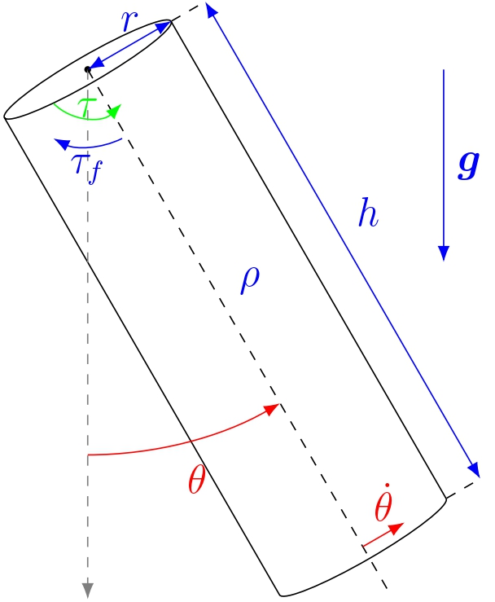
Problem Statement
Construct a controller for pendulum swing
Neuromorphic
Act on torque
Use angular position and velocity
Symmetric oscillations
Control at a desired amplitude
Follow natural frequency of system

Slide 3
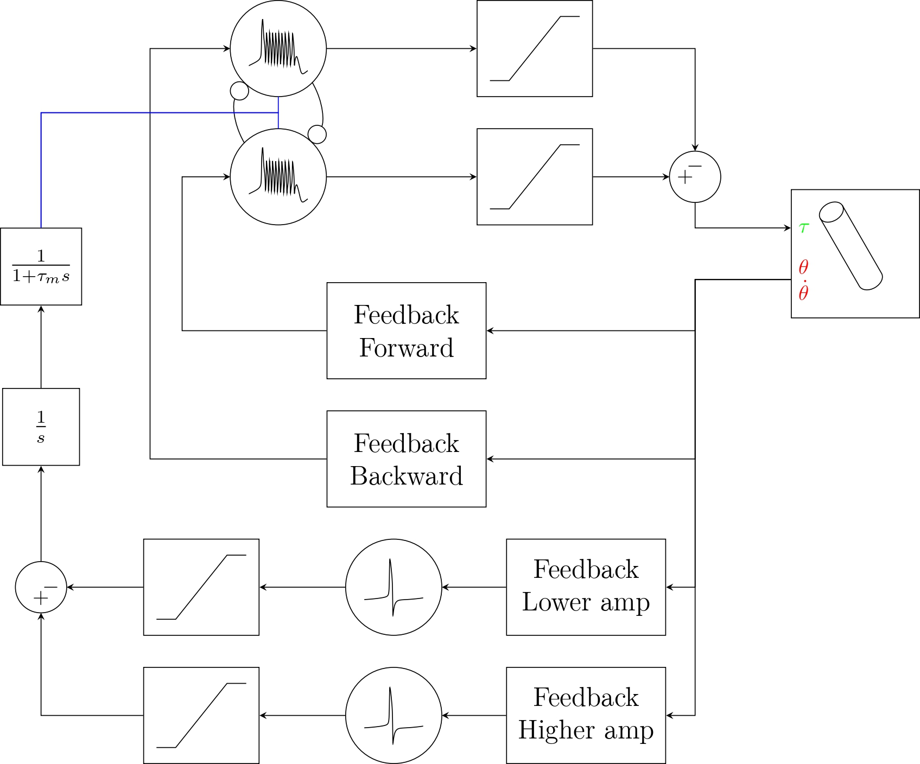
Neuromodulated Controller
Composition
2 Bursting neurons
2 Spiking neurons
4 Feedbacks
2 Synapses
1 Integrator
Challenges
Design Controller-Pendulum Actuation Interface
Design Pendulum-Controller Sensing Interface
Simulate Controller

Slide 4
Swing Control

Slide 5
Amplitude Control

